Slide 1
Building chatbots with MS Bot Framework
Using LUIS.AI

Slide 2
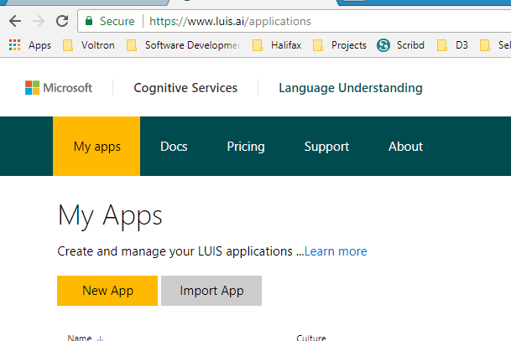
At www.luis.ai create a new app

Slide 3
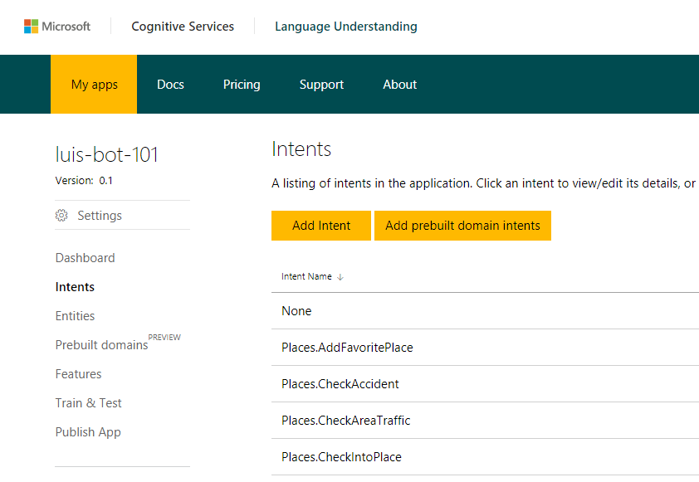
Configure Intents, Entities, Training

Slide 4
Copy files from here
https://github.com/code-monster-kevin/luis-bot101

Slide 5
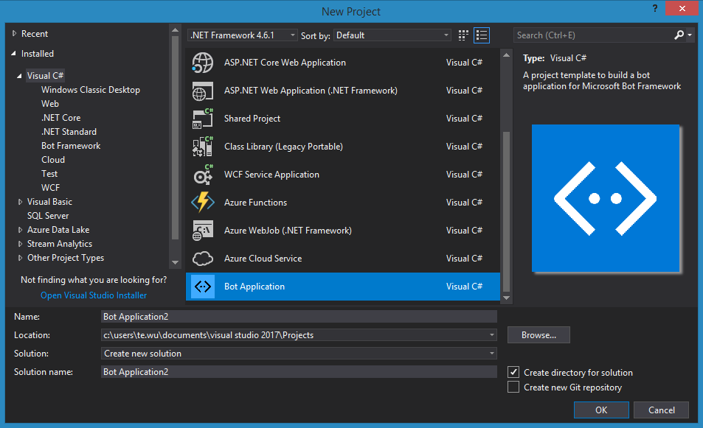
Create a new Bot Application

Slide 6
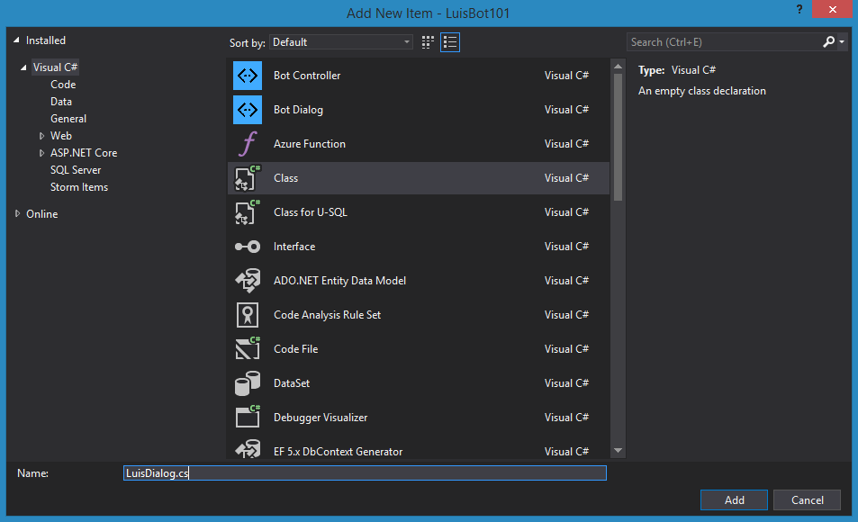
Create a new “LuisDialog.cs” class in “Dialogs”

Slide 7
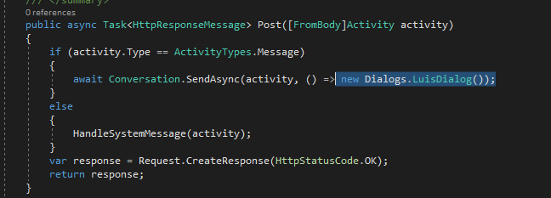
MessageController, change to LuisDialog

